Slide 1
ANTECEDENTS OF BRAND HATE: DOES GENDER MATTER?
Dr. Cid Gonçalves Filho -Universidade FUMEC, Brazil
Dra. Flavia Braga Chinelato. - CENTRUM PUCP, Peru
Ms. Ennius Marcus - Universidade FUMEC, Brazil

Slide 2
Brand Hate and Consumer Brand Relationship
MEN X WOMEN
Significant differences in behavior (Nawaz et al.,2020)

Slide 3
OBJECTIVES
(1) to determine the antecedents of brand hate comparing two services categories, with mid-touch and high touch interactions with consumers;
(2) to identify gender differences regarding the determinants of brand hate, enabling a targeted approach of brand and consumer experience strategies.

Slide 4
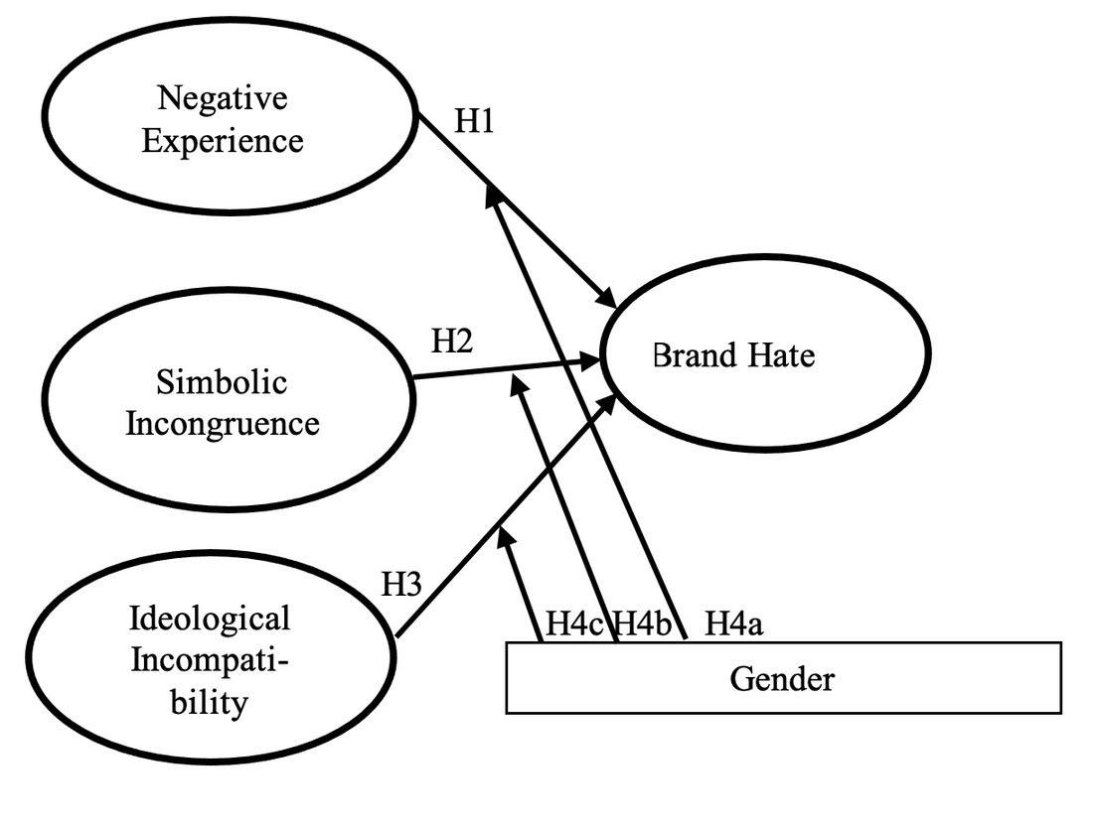
Hypothetical Model

Slide 5
Methodology
TWO STUDIES...
Study 1:
- Accomplished a survey with 307 consumers of mobile phone operators (MPO).
Study 2:
- With the same constructs, involving 450 respondents (students) from higher education institutions (HIEs).
The objective was to evaluate antecedents of brand hate to MPO and HIEs.

Slide 6
Findings
(1) Study 1 and Study2: Ideological incongruity have no differences in both samples.
(2) Negative experience presents higher effects (β=0.421) at HEIS than on MPO (β=0.159).
(3) Symbolic incongruence presents a higher weight on MBOs (β=0.450) than HEIs (β=0.117).
What about gender?

Slide 7
FINDINGS
About gender differences...
(1) In both studies, women presented significant higher weights regarding ideological incompatibility (β=0.417 MBO; β=0.287 HEIS) than men (β=0.132ns MBO; β=0.195 HEIS). So, women are more sensitive to moral issues and ethical behavior than men...?
(2) Negative experience is more important for men in both samples.
(3) No significant differences regarding
Symbolic incongruence on both studies.

Slide 8
SO...
This research demonstrates that the antecedents of brand hate are different for each gender in both studies and suggests it also would depend on the service category.
In this sense, firms should execute marketing research to understand gender differences regarding negative brand relationships, shape brand strategies, and design consumers´ journeys that accomplish these differences.

Slide 9
Thank you!
Dr. Cid Gonçalves Filho
cid@fumec.br
Dra. Flavia Braga Chinelato
fchinelato@pucp.edu.pe

